Slide 1
More About Exception Handling
Chapter 9

Slide 2
Kinds of Exceptions
Checked exception
Must be caught in catch block
Or declared in throws clause
Unchecked exception
Also called run-time
Need not be caught in catch block or declared in throws
Exceptions that coding problems exist, should be fixed

Slide 3
Kinds of Exceptions
Examples why unchecked exceptions to are thrown
Attempt to use array index out of bounds
Division by zero
Uncaught runtime exception terminates program execution

Slide 4
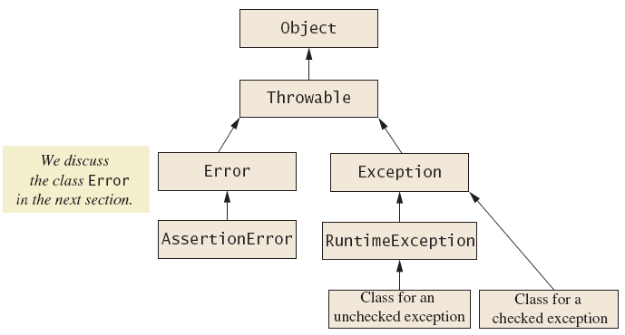
Kinds of Exceptions
Figure 9.1 Hierarchy of the predefined exception classes

Slide 5
Errors
An error is an object of class Error
Similar to an unchecked exception
Need not catch or declare in throws clause
Object of class Error generated when abnormal conditions occur
Errors are more or less beyond your control
Require change of program to resolve

Slide 6
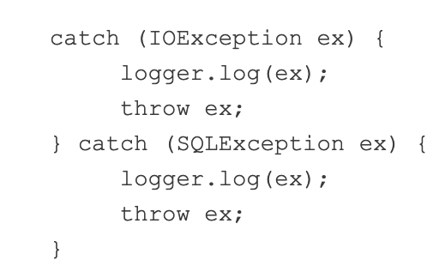
Handling Multiple Exceptions
In Java SE 7 and later, a single catch block can handle more than one type of exception. This feature can reduce code duplication and lessen the temptation to catch an overly broad exception.

Slide 7
Handling Multiple Exceptions
In releases prior to Java SE 7, it is difficult to create a common method to eliminate the duplicated code because the variable ex has different types.
https://docs.oracle.com/javase/8/docs/technotes/guides/language/catch-multiple.html

Slide 8
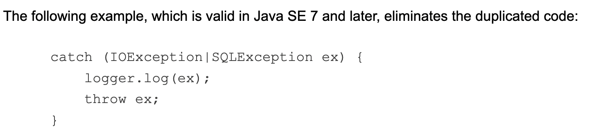
Handling Multiple Exceptions

Slide 9
Handling Multiple Exceptions
Note: If a catch block handles more than one exception type, then the catch parameter is implicitly final. In this example, the catch parameter ex is final and therefore you cannot assign any values to it within the catch block.

Slide 10
The finally Block
Possible to add a finally block after sequence of catch blocks
Code in finally block executed
Whether or not execution thrown
Whether or not required catch exists

Slide 11
Rethrowing an Exception
Legal to throw an exception within a catch block
Possible to use contents of String parameter to throw same or different type exception

Slide 12
Class ArrayList
The Java API provides several predefined data structures, called collections, used to store groups of related objects in memory
ArrayList (package java.util) provides a convenient solution to this problem—it can dynamically change its size to accommodate more elements. The T (by convention) is a placeholder—when declaring a new ArrayList, replace it with the type of elements that you want the ArrayList to hold. Example: ArrayList<String> list = new ArrayList(); ArrayList() ArrayList(int initialCapacity)
https://docs.oracle.com/javase/8/docs/api/?java/util/ArrayList.html

Slide 13
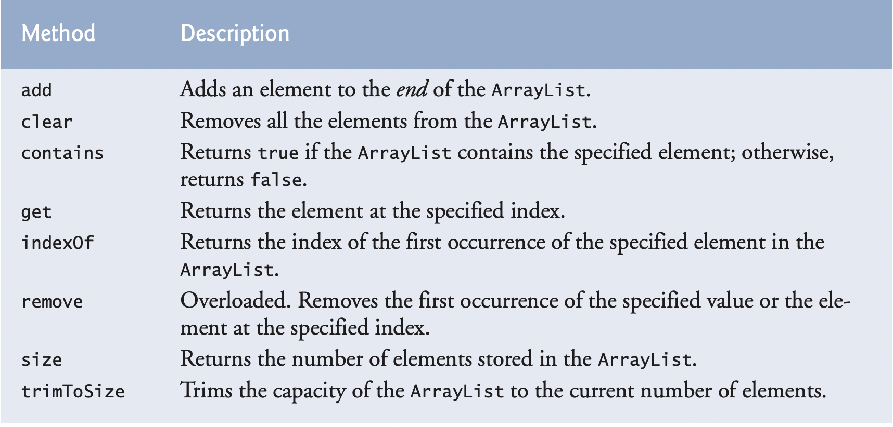
Class ArrayList

Slide 14
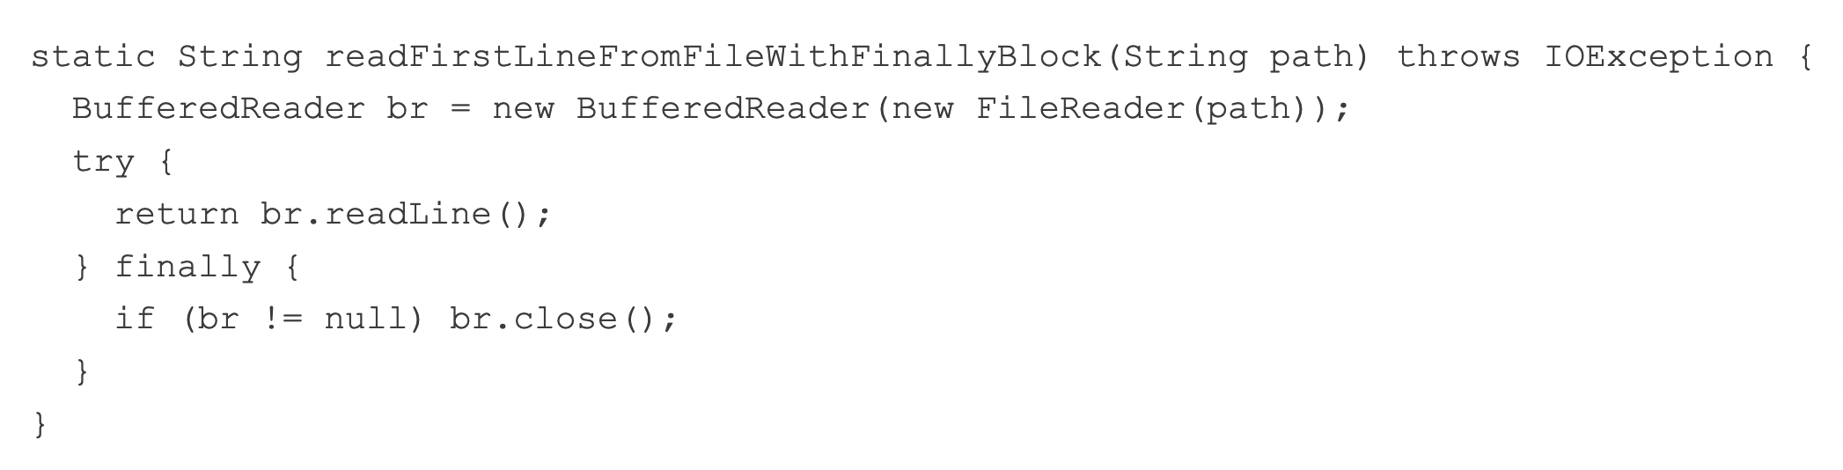
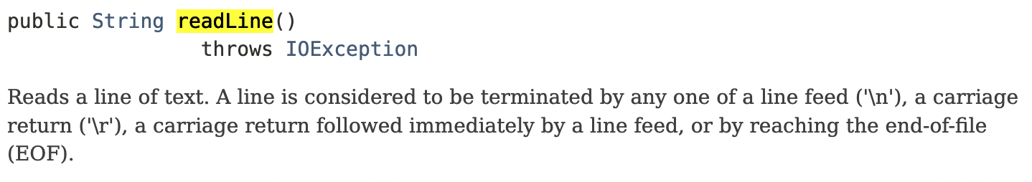
Try with Resource
Prior to Java SE 7, you can use a finally block to ensure that a resource is closed regardless of whether the try statement completes normally or abruptly.

Slide 15
Try with Resource
The try-with-resources statement is a try statement that declares one or more resources. A resource is as an object that must be closed after the program is finished with it.
The try-with-resources statement ensures that each resource is closed at the end of the statement.
Any object that implements java.lang.AutoCloseable, which includes all objects which implement java.io.Closeable, can be used as a resource.
https://docs.oracle.com/javase/8/docs/technotes/guides/language/try-with-resources.html

Slide 16
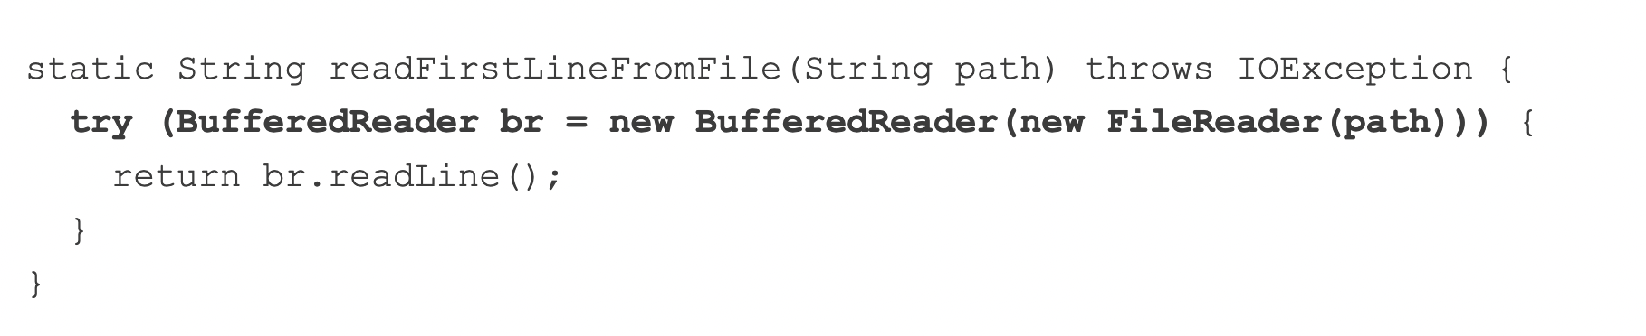
Try with Resource
The try-with-resources statement is a try statement that declares one or more resources. A resource is as an object that must be closed after the program is finished with it.
A resource is as an object that must be closed after the program is finished with it.

Slide 17
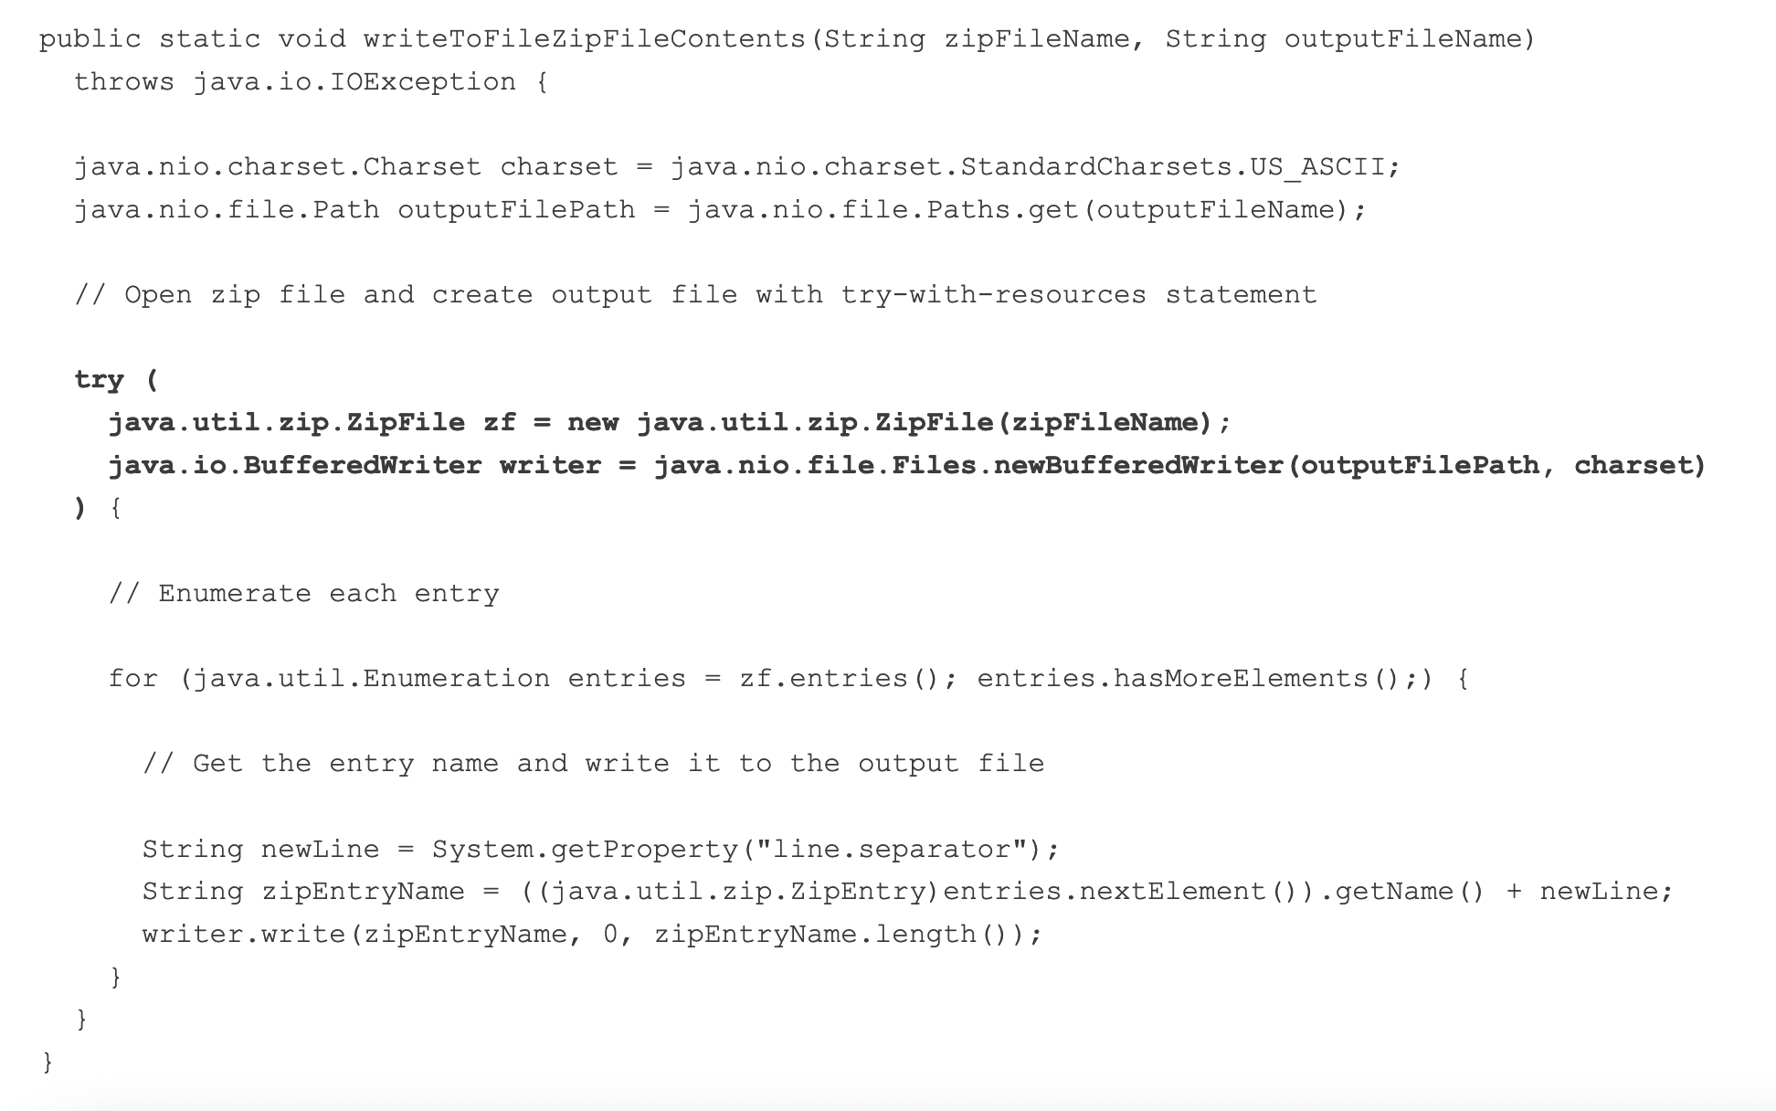
Try with Resource

